Slide 1
Introduction to Azure Function Apps with Power Apps
Saurabh Pimpalgaonkar
Notes:
test

Slide 2


Saurabh Pimpalgaonkar
Full-stack developer / Manager at KPMG Canada. With over 13 years of experience developing desktop, mobile and web enterprise applications using Microsoft .NET Framework, Dynamic 365, SQL Server and Azure technologies.
I have a passion for both backend and frontend development and also in the cloud with Microsoft Azure.
LinkedIn: https://www.linkedin.com/in/saurabh-pimpalgaonkar-370a607b/
Twitter: https://twitter.com/hershal1999
Email: spimpalgaonkar@kpmg.ca

Slide 3


Objective
Overview Power Apps
Power Apps Connectors
Overview Azure Functions
Demo – Integrating Power Apps with Azure Functions

Slide 4
Overview: Power Apps

Slide 5
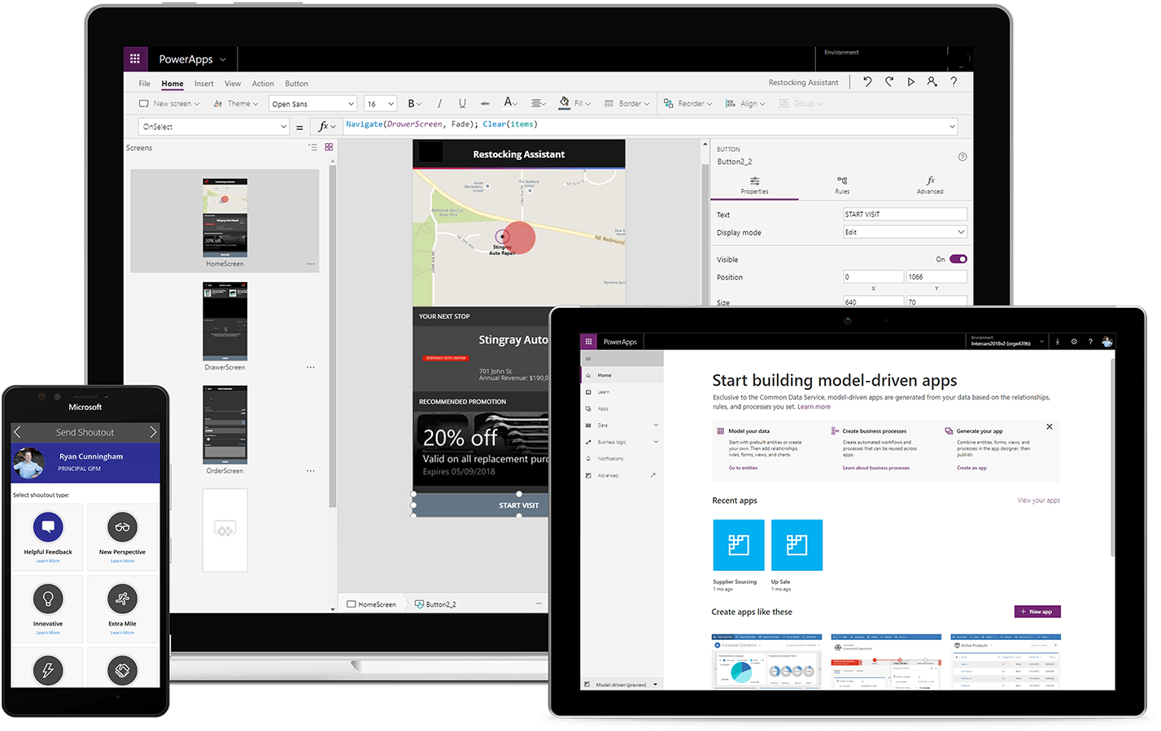
What is Power Apps?
Microsoft Power Apps is a service for creating and using custom business apps across platforms
Connect to existing systems and data sources
Build apps, forms, and workflows without writing code
Publish apps instantly for web and mobile

Slide 6
Power Apps Components
Four major components
Canvas Apps
App that can be build without writing code
User friendly designer (Power Apps Studio)
Model-Driven Apps
Starts with business data model
Automatically generates responsive UI
Portals
External facing website
Create and view data in Common Data Service
Common Data Service
Underline data platform that allows you to store and model business data

Slide 7
Power Apps Connectors

Slide 8
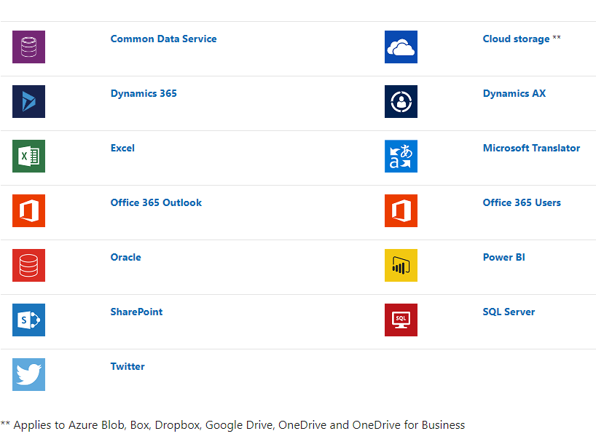
Types of Connectors
Standard Connectors
Over 325+ prebuild connector for services are available
Custom Connectors
Used for calling APIs, service and systems that are not available as standard connectors
Can be created using OpenAPI definition, Postman Collections or from scratch
*Source : https://docs.microsoft.com/en-us/powerapps/maker/canvas-apps/connections-list

Slide 9
When to use Custom Connector?
Scenarios when you use custom connectors:
Need to add custom logic on Server side for further processing.
Connecting with custom data source which are not provided by standard connectors

Slide 10
Features of Custom Connector?
Full control over custom API
Secured
Generic OAuth 2.0
OAuth 2.0 for specific services, including Azure Active Directory (Azure AD), Dropbox, GitHub, and SalesForce
Basic authentication
API Key
Same Custom Connector can be used Logic Apps, Power Automate, and Power App.
Include in your Solution for migration

Slide 11
+
=
Highly Scalable, Easy to develop,
Easy to maintain, Cost-effective
Custom Connector Power Apps Solution

Slide 12
Overview: Azure Function Apps

Slide 13
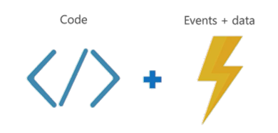
What is Azure Functions?
Azure Functions are a serverless, event driven experience that extends the existing Azure App Service platform
Azure Functions are “nanoservices” that can scale based on demand (only paying for the resources you use)
Think of Azure Functions as…

Slide 14
Features of Azure Functions
Choice of language
Pay-per-use pricing model
Bring your own dependencies (NuGet, NPM)
Integrated security
Simplified integration
Flexible development / deployment
Open-source
Quickly caches and uncaches

Slide 15
Supported languages and tools
Azure Functions can be created in C#, Node/JavaScript, Python, F#, PHP and scripting languages like PowerShell, Batch and Bash
Azure Functions can even run EXE’s or call into DLL’s

Slide 16
What can I do with Azure Functions?
Azure Functions are great for processing data, integrating systems, working with IoT, simple API’s and microservices
Azure Functions provide templates for a number of key scenarios
Azure Functions supports
Triggers - a way to start execution
Bindings - a way to simplify code for input and output of data

Slide 17
Available trigger templates
BlogTrigger
EventHubTrigger
Generic webhook
GitHub webhook
HttpTrigger*
QueueTrigger
ServiceBusQueueTrigger
ServiceBusTopicTrigger
TimerTrigger
*Every function type with the exception of the HttpTrigger type will require a storage account.

Slide 18
Securing your Azure Functions
HttpTriggers can be protected by Oauth providers such as:
Azure Active Directory
Microsoft Account
Facebook
Google
Twitter

Slide 19
Demo – Integrating Power Apps with Azure Functions
Creating an Azure function (using visual studio).
Creating a Swagger definition for it.
Creating a new connection in Power Apps for Custom API.
Adding the connection as Content Source in Power Apps.
Calling the function in the app.

Slide 20
References
https://azure.microsoft.com/en-us/services/functions/
https://functions.azure.com/
https://github.com/Azure/Azure-Functions
https://azure.microsoft.com/en-us/pricing/details/functions/
Azure - Serverless Architecture with Azure Functions
Azure Storage Explorer
https://docs.microsoft.com/en-us/powerapps/powerapps-overview

Slide 21
Any Questions?

Slide 22
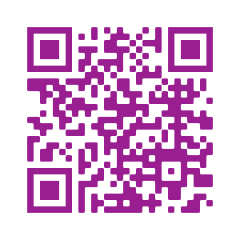
Please fill out the survey! & Win Swags!!
https://www.powerplatformbootcamp.com/survey

Slide 23
Thank You For Attending

